Slide 1
Week 3 progress

Slide 2
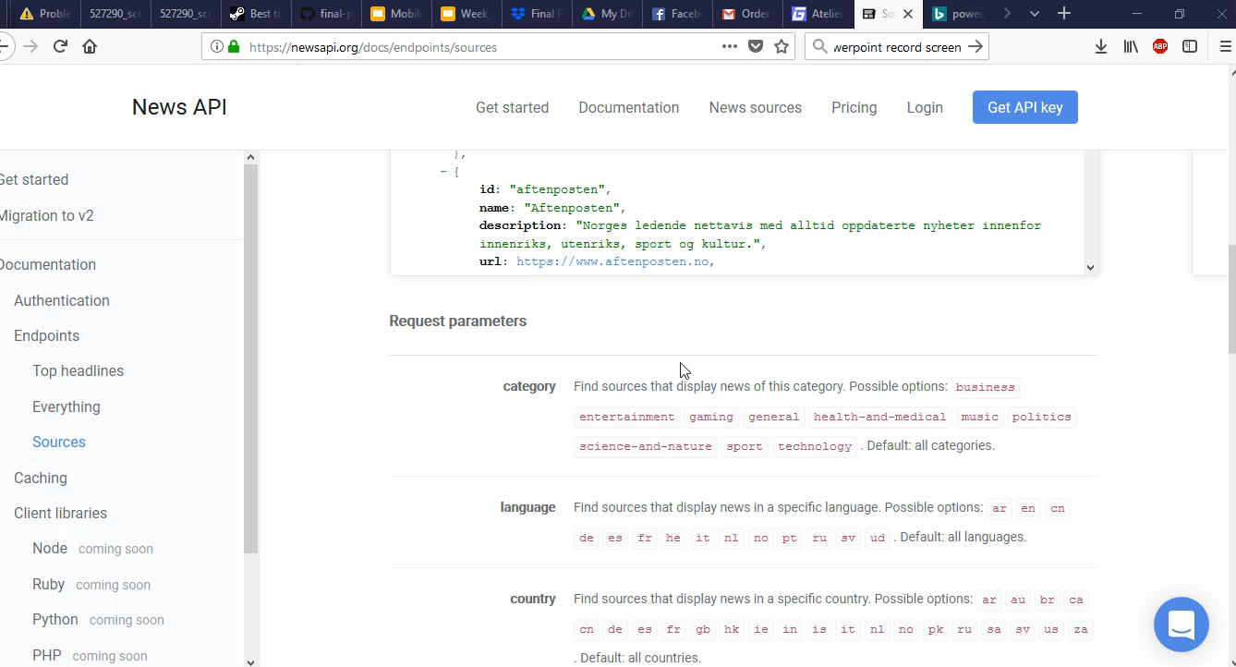
Demo

Slide 3
What we have done
Robert: Refactored Menu events to work with with the new api, changed Navigation view menu to dynamic based on the News categories based on the API
Chirs: refactored article and source methods to use version 2 of newsapi and take optional arguments and added everything query, run query with a search word and get all articles with said topic
Jacob: Set up user registration for firebase and made registration and sign in buttons Added ability to download image bitmaps asynchronously for each article, More back end work on firebase set up and started setting up for history views and user accounts

Slide 4
What needs to be done
Need to run query to get categories instead of hard coding.
Make a search bar to search for topics.
Add user account Page
Finish history DB

